Slide 1
Pre to 3 Home Visitation Program
Vanderburgh County Health Department
February 20, 2024

Slide 2
Vanderburgh county data
30
IMR = Infant Mortality Rate
20
10
0
2011
2012
2013
2014
2015
2016
2017
2018
2019
2020
2021
White IMR
IN IMR
Hispanic IMR
Black IMR

Slide 3
Vanderburgh data
2017-2021 Stable Black Infant Mortality Rate
Vanderburgh 19.1 / 1000 live births
2nd highest in Indiana
Black infants are almost 2.5x more likely to die before their first birthday than White infants
47713
47713
Vanderburgh County
Vanderburgh County

Slide 4
What is pre to 3
Home visiting program utilizing community health workers (CHW), client advocates, and registered nurses
Provide long-term, consistent, hands-on support for families utilizing an evidence-based curriculum
Designed to reduce infant mortality and improve maternal/child outcomes

Slide 5
Program objectives
Improve maternal/child outcomes
Foster the parent-child interaction
Establish healthy environment for early childhood development
Chart paths to family self-sufficiency

Slide 6
enrollment
Anyone who is pregnant or has a baby less than 90 days old
Can remain in the program until 3 years of age
No enrollment requirements based on
Income
Parity
Education level

Slide 7
structure
Evidence Based Curriculum
Pre to 3 Program Supervisor
Client Advocate & Intake Coordinator
Registered Nurse
Community Health Worker
Community Health Worker
Community Health Worker
Program Manager & QA Coordinator
Data Analyst
Notes:
Unique model using CHWs
Only program billing for CHWs in Indiana

Slide 8
Screenings & assessments
ACES/Resilience Questionnaire
Intimate Partner Violence
Edinburgh Postnatal Depression Scale
ASQ-3 and ASQ:SE-2
Home Safety
Healthy Families Parenting Inventory
Social Determinants of Health
Preeclampsia Risk Screening
Notes:
Highlight SDOH screenings

Slide 9
Current Numbers
1,151
237
487
58
clients who completed an intake appointment
clients currently active in Pre to 3
births while enrolled in the program (2019 YTD)
Program graduates
(2019 YTD)

Slide 10
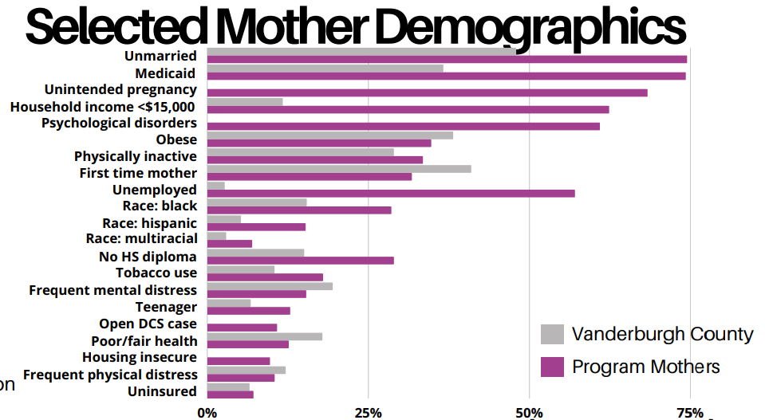
Notes:
Highlight Medicaid, income, unemployed

Slide 11
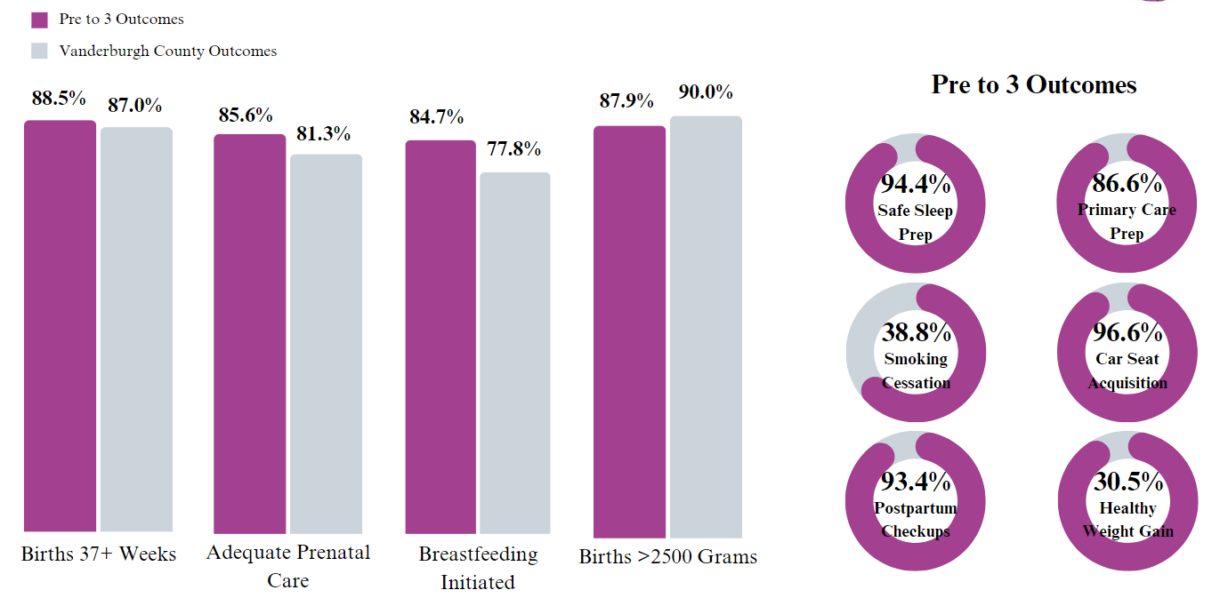
Pre to 3 client Outcomes

Slide 12
Expansion & funding sources
Expansion
Duplicating program in Dubois County
Anticipate duplicating to two additional counties in 2024
Funding Sources
Revenue/billing
Grants
Local Non-Profit Foundations
Purdue Partnership

Slide 13
Pre to 3 program helps me be the mom I want to be while helping me practice self-regulation and social emotional skills.
After being referred to the Pre to 3program by the VCHD lab, she is now sober and in recovery from substance use disorder. She was wary of the program at first but promised herself to give it a try. She met with the Pre to 3 team from 8 weeks prenatal until now…18 months postpartum! She proudly shares how the tools learned in Pre to 3 not only helps her be the mom that she wants to be for her child but helps her practice self-regulation and social emotional skills that aid in managing her recovery.

Slide 14
THANK YOU

Slide 15
County Commissioners
Cheryl Musgrave President
Justin Elpers Vice President
Mike Goebel Member

Slide 16
VCHD Board of health
Dr. Mark Royer, MD, MBA Chair
Sandie Strader-McMillen, MHA, MBA Vice-Chair
Dr. Mark E. Wohlford, DDS, PhD Member
Dr. R Michelle Galen, MD, FAAFP, FAWM Member
Dr. Julie Wohrley, MD Member
Margaret Musgrave Member
Dr. Maria Del Rio Hoover, MD Member

