Slide 1
INDIANA UNIVERSITY SCHOOL of MEDICINE – EVANSVILLE (IUMS-E) ALLIED HEALTHCARE CONSORTIUM: 2015
An incredible motor !

Slide 2
Members of the Consortium
Schools Hospitals
IUMS –E Deaconess
USI St. Mary Med Center
UE Memorial – Jasper
Ivy Tech ??? Good Samaritan - Vincennes
Other Critical Programs: IU Dental and the Indiana Clinical and Translational Science Institute (CTSI)

Slide 3
No One Else
has
This Consortium Format
!!!

Slide 4
DRIVERS
Indiana – Now, Ranked 37th in the U.S. in physicians per 100,000 residents.
Meet Projected Need for 30% more IUMS Doctors,
AND Nurses, Physician Assistants & Allied Medical People BY 2030
Affordable Care Act Coupled with a Graying Population
Availability of Evansville’s Teaching Beds
Need for new Healthcare Models - Wellness
Team Care Concept – Everyone participates in Care
IUMS-E Medical Student Enrollment Grows from 24 in TWO years up to 50/class/year in FOUR years
Add GME Residencies in Hospitals

Slide 5
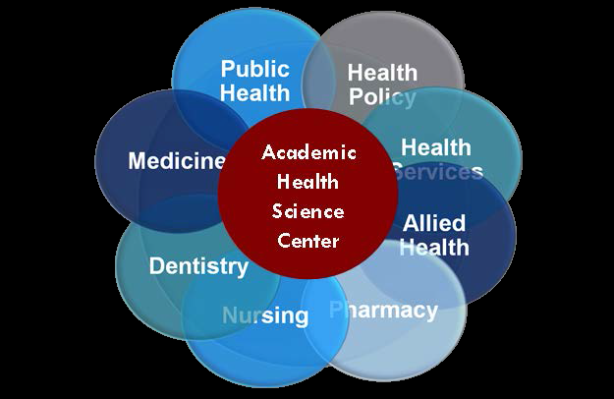

Slide 6
Locations of Satellite Campuses
Bloomington
Evansville
Fort Wayne
Gary
Muncie
South Bend
Terre Haute
West Lafayette

Slide 7
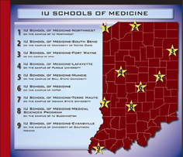

Slide 8
The Construction Team
US Health Care
(development arm of Skanska)
Evansville Health Realty
City of Evansville
Skanska

Slide 9
Now

Slide 10
Original Lease Proposal - I for 172,000 sq. ft.

Slide 11
Initial Evansville City’s Funding Obligation for 172,000 sq. ft.
Building Construction - $37 million
Infrastructure and Incentives - ~$20 mil
Remember we already have $20 mil earmarked for Convention Hotel
The Downtown Tax Increment Limits
Indiana’s State contribution unknown then

Slide 12
Original Building

Slide 13
PROPOSED ALLIED HEALTH CONSORTIUM BUILDING

Slide 14
Proposed State Funding- II for IUMS to BUY for 223,000 sq ft Building Sent 1/15 223,000 sq. ft. Costing ~$123,100,000 !

Slide 15
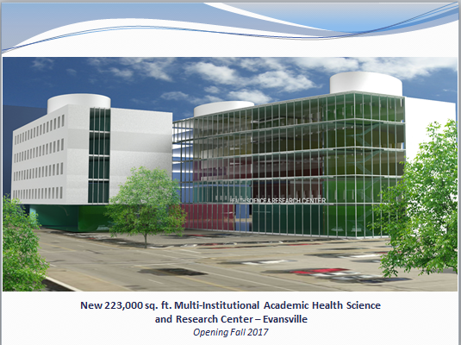

Slide 16
Final 2015 Funding Results - III for the Allied Health Consortium
The State has already put up $2 mil for planning
Total State Component Funding - $25.2 mil for IUMS-E, IU Dental and USI Nursing School
UE - ~$5.7 mil
No Building or Operational Funding
for Ivy Tech at this time
City of Evansville Continues to be Committed to ~$57 mil
The Building is to be a 145,000-sq-ft facility and IUMS-E gets 87,000 of it

Slide 17
And This is What We Get Now - III 145,000-sq-ft Facility… Great !

Slide 18
What Does
It Really Take To Make A Doctor ?

Slide 21
REMEMBER It Takes ~ $100, 000 over four years for the Hoosier Taxpayer to Graduate One In-State Medical Student. When a young doctor only completes his residency in Indiana, he/she will stay here only ~33 % of the time. If the medical student merely graduates from medical school here, he/she and goes elsewhere for his residency, he/she will end up back here in Indiana ~50% of the time If the student goes to medical school and residency in the same Hoosier locale, 78% of the time, they will stay in-state, most within 50 miles of the that site !

Slide 22
IMPORTANT ! Graduate Medical Education Residencies
Phase I 2017-2020
--Fellowships in Internal Medicine, Family Practice
Psychiatry, and Geriatrics
Phase II After 2020
-- General Surgery, Obstetrics/Gynecology, Other Specialties
Total - 80-100

Slide 23
TIMELINE
IUMS-E Associate Dean & Director , Dr. Steve Becker’s Dream – Lunch Spring of 2011
Downtown Site Picked by IU Board – 3/14
City Council Approved Bond Issue of $57 million - 4/14
City Buys Four Blocks of D Patrick Land - 6/14
State Funding Process On Going Now & Set by 4/30/15
D Patrick out of Downtown - ~9/15
Groundbreaking of Downtown Campus begins ~ 10/15 ?
Campus done – Fall of 2017 – Later ?
First Classes held on Downtown Campus – Prob. January 2018
Initially ~410+ Students and 150+ Faculty and Support People Work and Study there by Late 2017…everyday week day
Ivy Tech’s Joining Downtown Location?...Some now
& Then ? ALL in 3 Years

Slide 24
The Incredible Economic Motor:

Slide 25
Student Population Growth ! Up 63% in 10 years

Slide 26
NOW

Slide 27
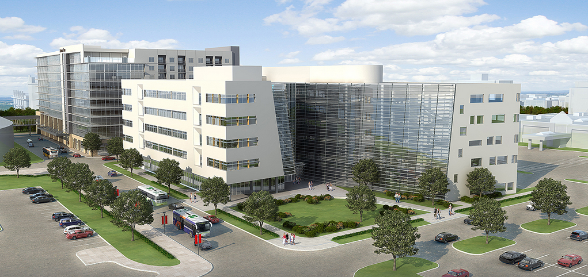
The Allied Health Consortium by 2025 ?

Slide 28
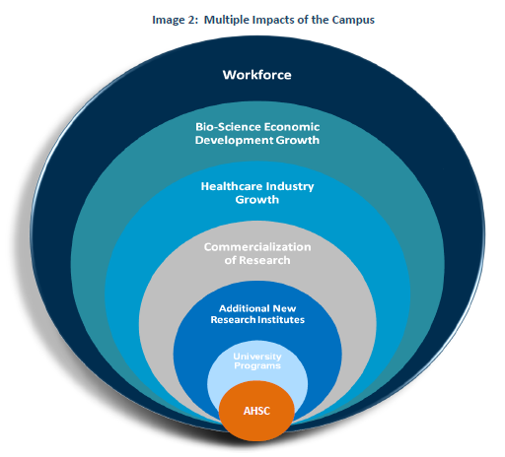

Slide 29
FUTURE STAGE - 2030

Slide 31
CONCLUSION
We will have Provided
the Means to Have
Adequate Healthcare Personnel
for our Region And State
for the NEXT 50-100 years !!!

Slide 32
PS …..
How many Hotels have You seen Change Hands or go Bankrupt ?
How many Medical Schools go Broke ?
How many Hotels next to Medical Schools go Broke ?

